Slide 1
__L1n__w@tch
Nine Quiz

Slide 2
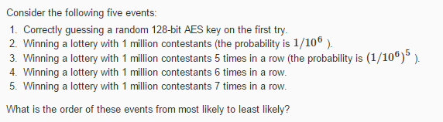
Question 1
dictionary['1'] = 1 / (2 ** 128) dictionary['2'] = 1 / (10 ** 6) # 1 million = 10^6 dictionary['3'] = (1 / (10 ** 6)) ** 5 dictionary['4'] = (1 / (10 ** 6)) ** 6 dictionary['5'] = (1 / (10 ** 6)) ** 7

Slide 3
Question 2
Suppose that using commodity hardware it is possible to build a computer for about $200 that can brute force about 1 billion AES keys per second. Suppose an organization wants to run an exhaustive search for a single 128-bit AES key and was willing to spend 4 trillion dollars to buy these machines (this is more than the annual US federal budget). How long would it take the organization to brute force this single 128-bit AES key with these machines? Ignore additional costs such as power and maintenance.

Slide 4
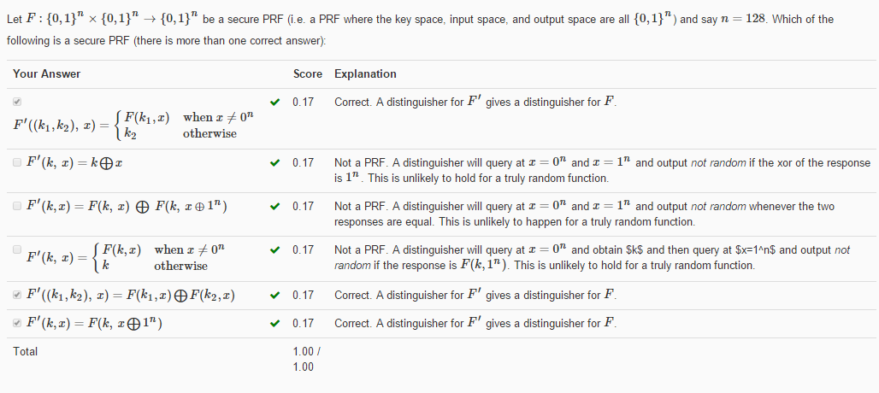
__L1n__w@tch
Question 3
解析：
安全的PRF的输出应该是和真随机序列是不可区分的。

Slide 5
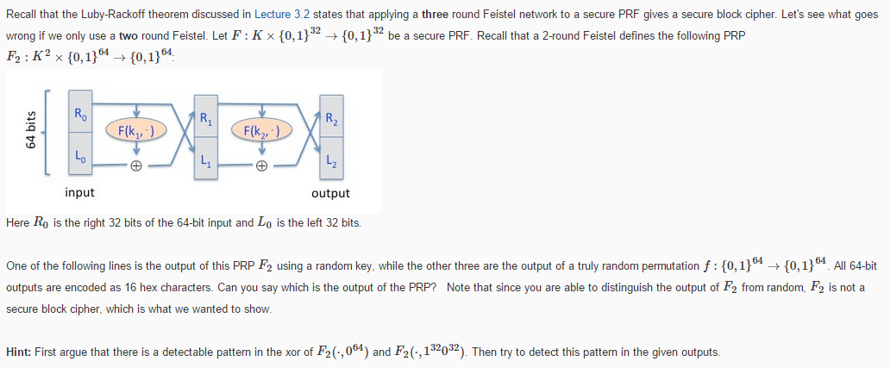

Problem_set_2-3思路
__L1n__w@tch
Question 4
利用L1 xor L2判断是否全为F，若是，这说明不是secure PRF
解析：

Slide 6
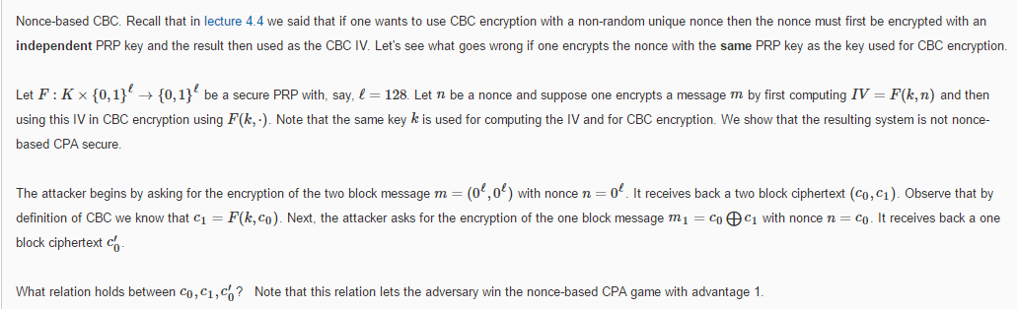
__L1n__w@tch
Question 5
解析：
C1 = F(k, c0)
C0' = F[k,c0 xor c1 xor F(k, c0)]
= F(k, c0)
= c1

Slide 7
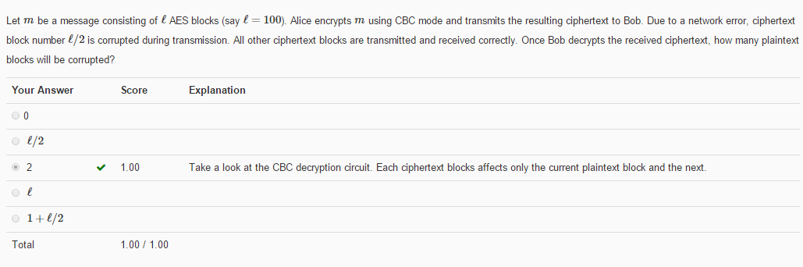
__L1n__w@tch
Question 6
解析：
这里应该是只有2个块坏，因为这个坏的块只影响到了它自己和用到它的下一个，再下一个并没有用到它所以不会坏的

Slide 8
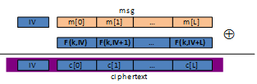
__L1n__w@tch
Question 7
Let m be a message consisting of ℓ AES blocks (say ℓ=100). Alice encrypts m using randomized counter mode and transmits the resulting ciphertext to Bob. Due to a network error, ciphertext block number ℓ/2 is corrupted during transmission. All other ciphertext blocks are transmitted and received correctly. Once Bob decrypts the received ciphertext, how many plaintext blocks will be corrupted?
解析：
随机数计数器模式
如图所示，一个块坏了
也就影响一个

Slide 9
__L1n__w@tch
Question 8
Recall that encryption systems do not fully hide the length of transmitted messages. Leaking the length of web requests has been used to eavesdrop on encrypted HTTPS traffic to a number of web sites, such as tax preparation sites, Google searches, and healthcare sites. Suppose an attacker intercepts a packet where he knows that the packet payload is encrypted using AES in CBC mode with a random IV. The encrypted packet payload is 128 bytes. Which of the following messages is plausibly the decryption of the payload:
解析：
用AES加密（128bits、256bits等），随机IV（16bits），CBC模式加密的密文。
随机IV共16个字节，加上密文与填充后，刚好是题目说的128字节的那个就是答案。

Slide 10
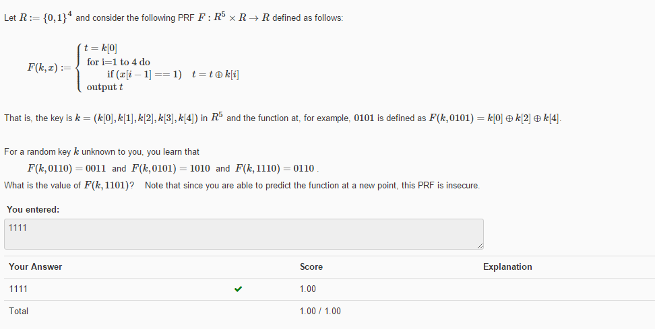
__L1n__w@tch
Question 9
解析：
F(k, 1101) = k[0] xor k[1] xor k[2] xor k[4]
利用性质：异或2次等价于没有异或。
异或掉给出来的三个即可

Slide 11
__L1n__w@tch
In the end
T
H
A
N
K
Y
0
U

